Slide 1
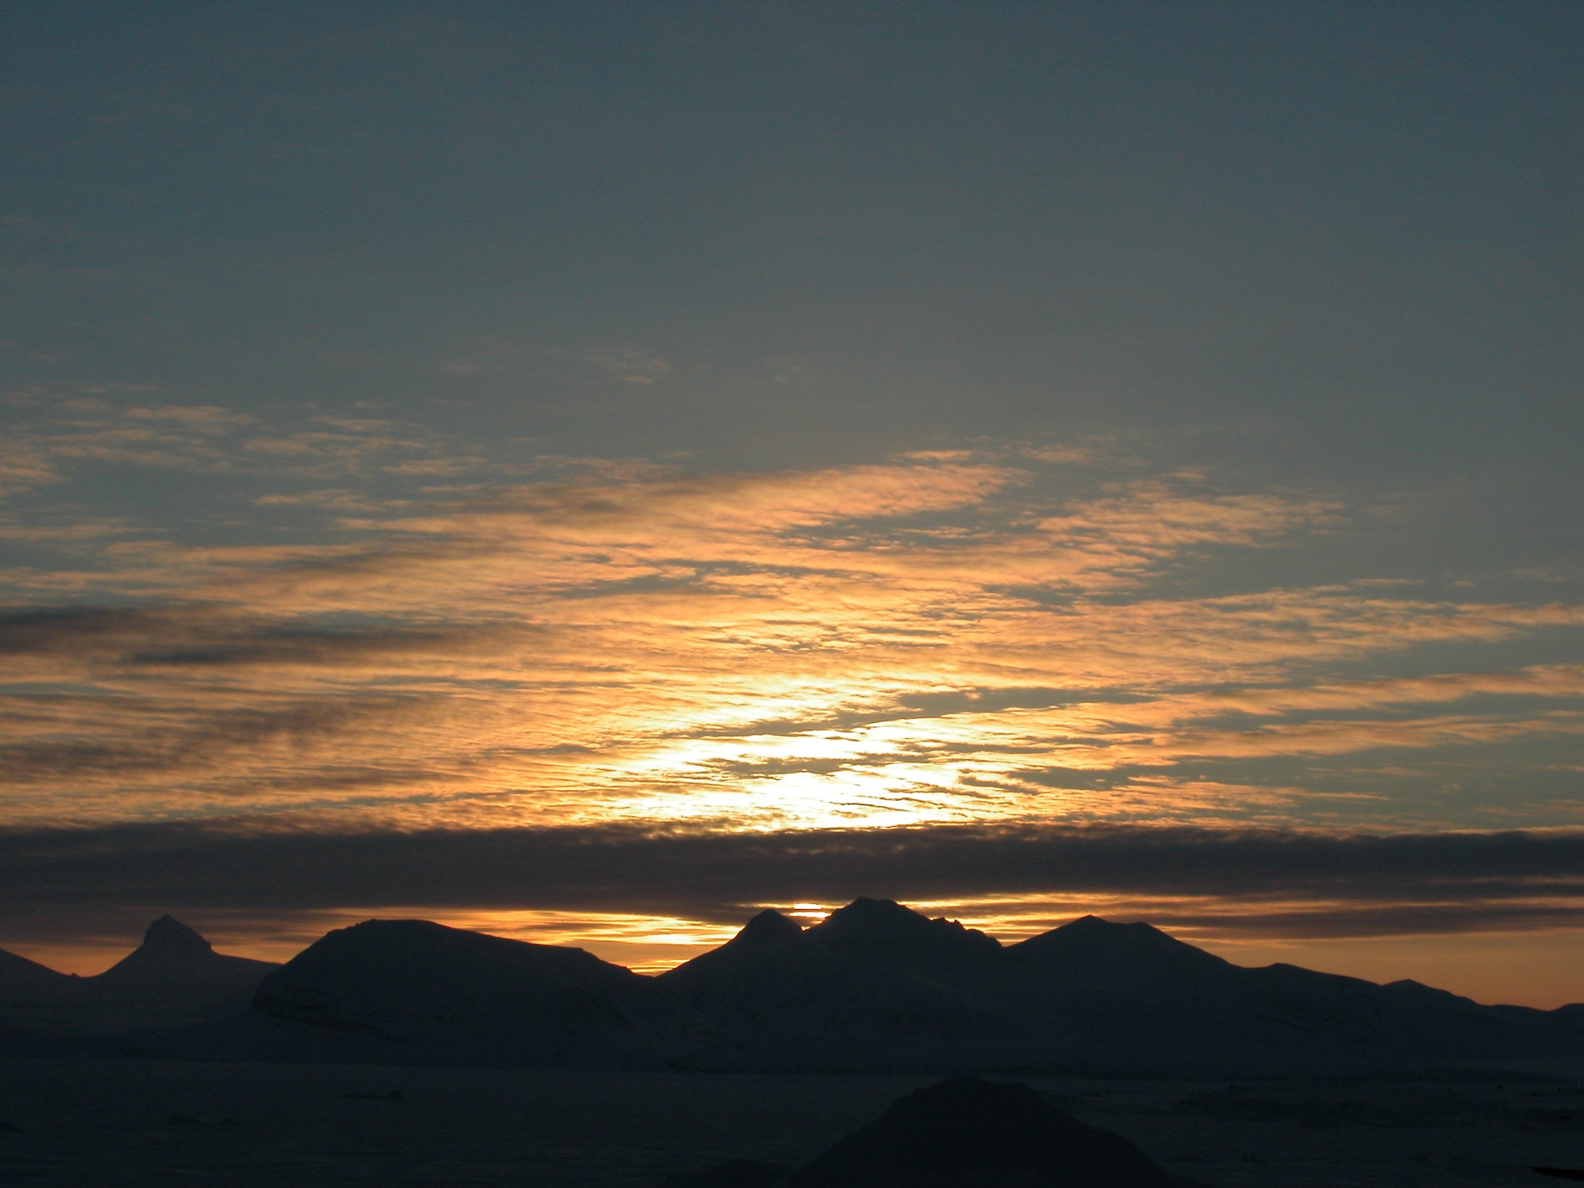
UNDERSTANDING THE IMPACT OF A CHANGING ARCTIC ON NORTHERN HEMISPHERE WEATHER AND CLIMATE
www.blue-action.eu @BG10BlueAction

Slide 2
WHY BLUE-ACTION?
Faced with a changing climate, businesses, policymakers, and local communities need to access reliable weather and climate information to safeguard human health, wellbeing, economic growth, and environmental sustainability.

Slide 3
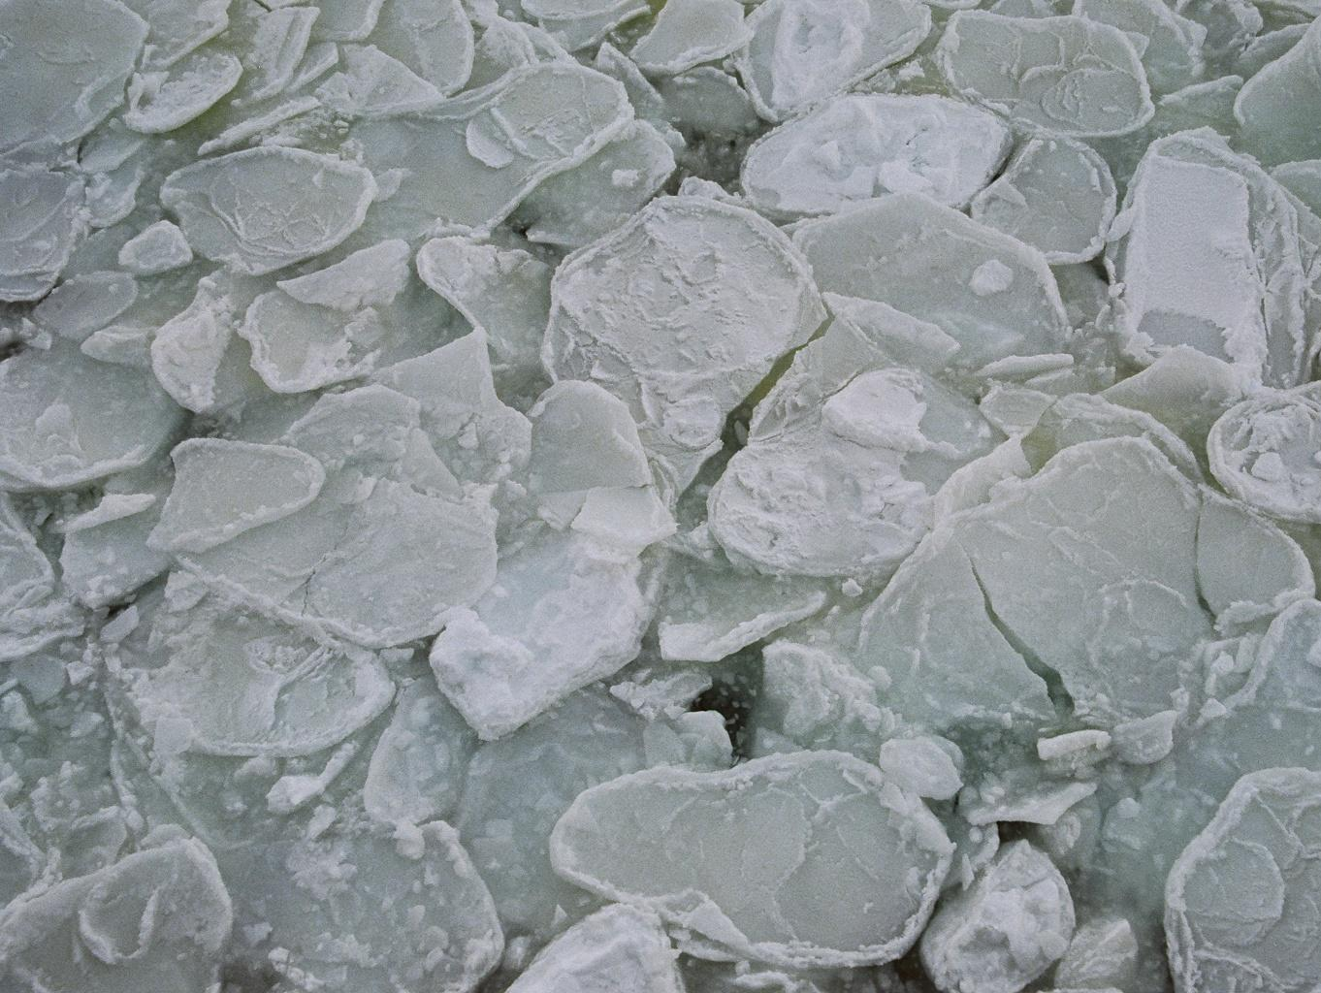
PROJECT SUMMARY
In response, Blue-Action aims to:
improve our understanding of the impact of a changing Arctic on Northern Hemisphere weather and climate;
improve the safety & wellbeing of people in the Arctic and across the Northern Hemisphere;
reduce the risks associated with Arctic operations and resource exploitation; and,
support evidence-based decision-making by policymakers worldwide.

Slide 4
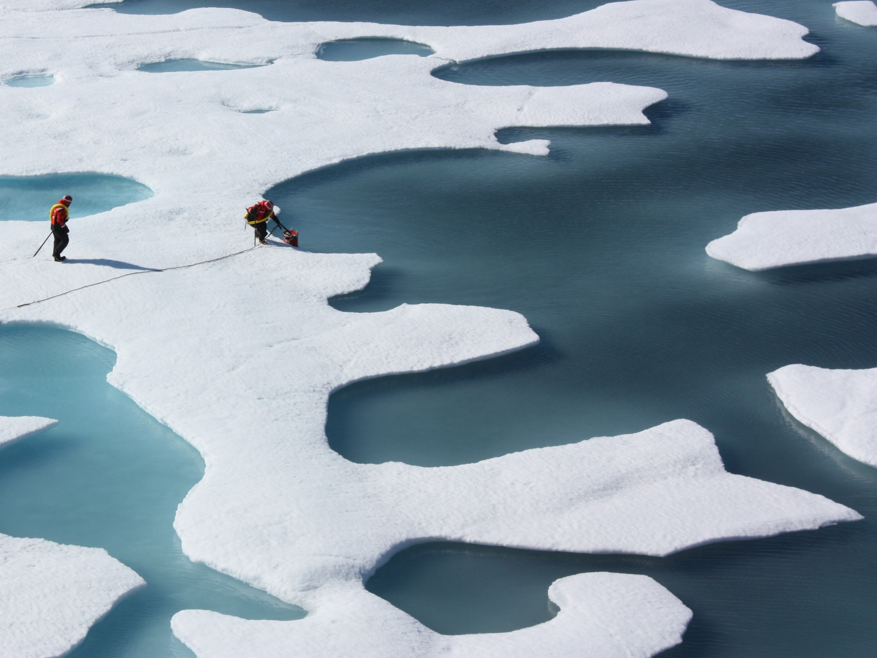
Blue-Action brings together experts from over 40 organisations in 17 countries across 3 continents to:
Develop new methods to characterise climate conditions where hazardous weather system forms across the Northern Hemisphere and establish their link to Arctic climate change.
Deliver an improved representation of Arctic warming and its impact on atmosphere and ocean circulation.
Enable robust and reliable forecasting to deliver better predictions at sub-seasonal to decadal scales.
NASA/Kathyrn Hansen

Slide 5
Blue-Action will also:
Embed scientific developments and improved model capability within international programmes through organisations including Copernicus C3S, WCRP, IPCC (AR6), JPI Climate and WMO (YOPP & PPP).
Co-design a series of case studies with organisations and industries that rely on accurate weather and climate forecasting, to apply new modelling techniques to cutting-edge climate services.
Communicate new insights, results, and messages – as well as data, model improvements and storylines – to a community of stakeholders for whom understanding climate change and associated environmental trends and risks is imperative.
NASA/Kathyrn Hansen

Slide 6
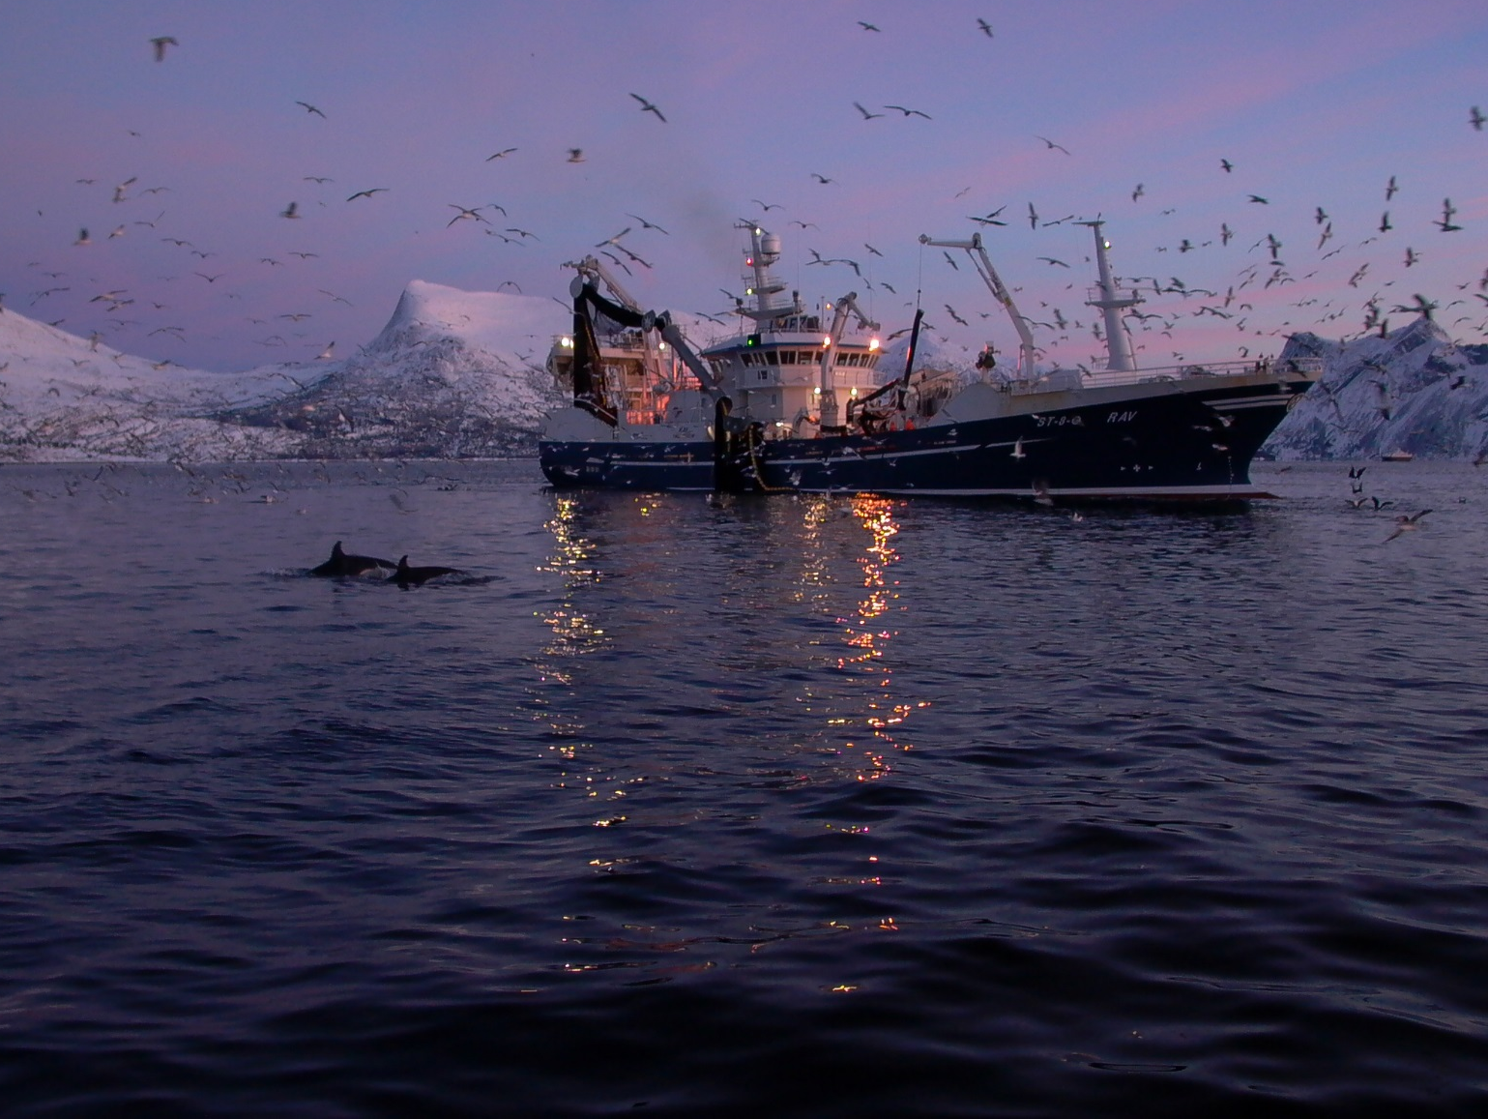
Blue-Action aims to work with:
Researchers and projects focussing on Arctic and northern hemisphere observational monitoring, climate modelling, forecasting, and climate services.
Governments and policymakers in need of weather and climate information for evidence-based decision-making.
NGOs, public sector bodies, and community organisations interested in extreme weather events, climate services, forecasting, and climate change.
Businesses or industries who rely on seasonal to decadal climate predictions, risk estimates of extreme weather and climate events, or who would like to work with Blue-Action to co-develop climate services and tools.

Slide 7
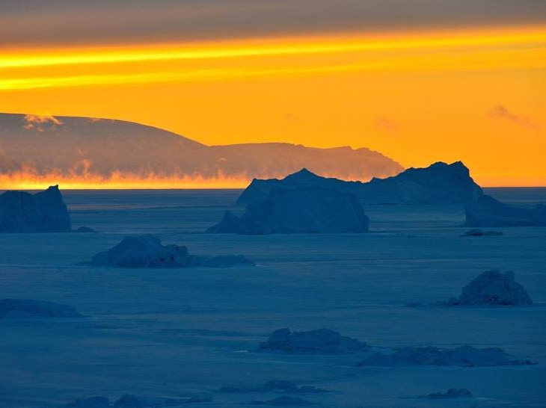
Project coordinators:
Steffen Olsen, Danish Meteorological Institute, smo@dmi.dk
Daniela Matei, Max Plank Institute for Meteorology, daniela.matei@mpimet.mpg.de
Project office:
Chiara Bearzotti, Danish Meteorological Institute, chb@dmi.dk
Communication, Dissemination, Engagement, and Exploitation Officer:
Raeanne Miller, SRSL, Raeanne.Miller@sams.ac.uk

Slide 8
UNDERSTANDING THE IMPACT OF A CHANGING ARCTIC ON NORTHERN HEMISPHERE WEATHER AND CLIMATE
The Blue-Action project has received funding from the European Union’s Horizon 2020 research and innovation programme under grant agreement No 727852
www.blue-action.eu
@BG10BlueAction

