Slide 1
WP5 – Case Study 4
Climate Services for Marine Fisheries
Presenter and lead: Mark R. Payne (DTU Aqua) Brian MacKenzie, Christian Skov, Anna K. Miesner, Christian Kiær (DTU Aqua) Martin Pastoors (PFA), Claus Sparrevohn (DPPO)

Slide 2
Goal
To develop climate services to support marine fisheries

Slide 3
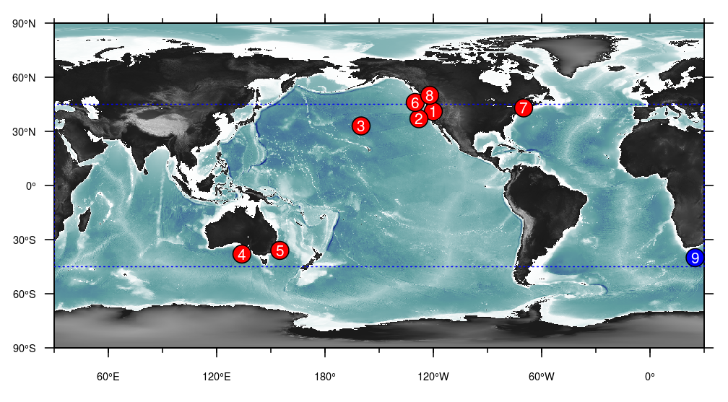
Review of existing marine climate services
Payne MR et al. (2017) Front. Mar. Sci.

Slide 4
Main results
Proposed Climate Service | Operationalise?
Spawning distribution of blue whiting | Yes
Summer feeding distribution of mackerel | Yes
Summer feeding distribution of Bluefin Tuna | Yes
Recruitment of sandeel in North Sea | Yes
Recruitment of herring in the North Sea | No – no clear sign of predictive power.
Recruitment of cod in the Barents Sea | Yes
Timing of sandeel remergence | Yes
Timing of mackerel migration into Danish waters | Yes
Timing of garfish migration into Danish waters | Yes
Timing of herring spawning in English channel | No. No linkage found

Slide 5
Users of CS4 Climate Services in Blue-Action
1. Management and Monitoring of Fish Stocks
Monitoring of distribution of fish stocks (ICES)
Advice and management of fish stocks (ICES, EU)
2. Members of the general public
Recreational fishers (timing of migrations)
3. Fishing industry
Pelagic Freezer-trawler Association (PFA)
Denmarks Pelagic Producers Organisation (DPPO)
Marine Ingredients

Slide 6
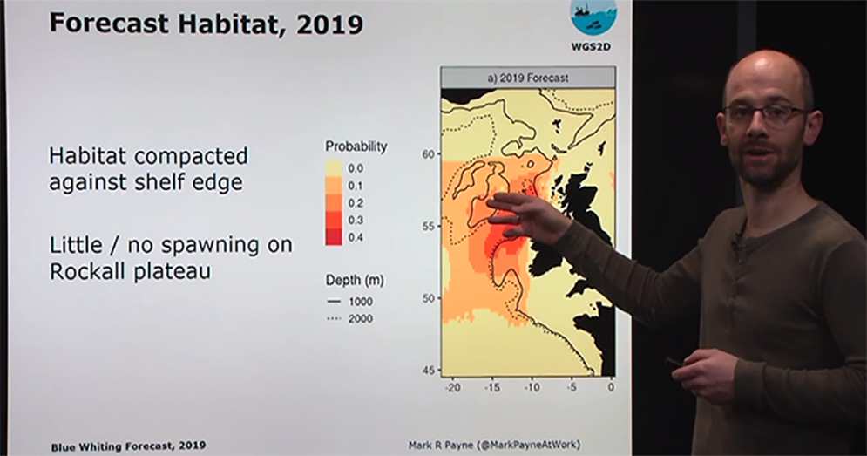
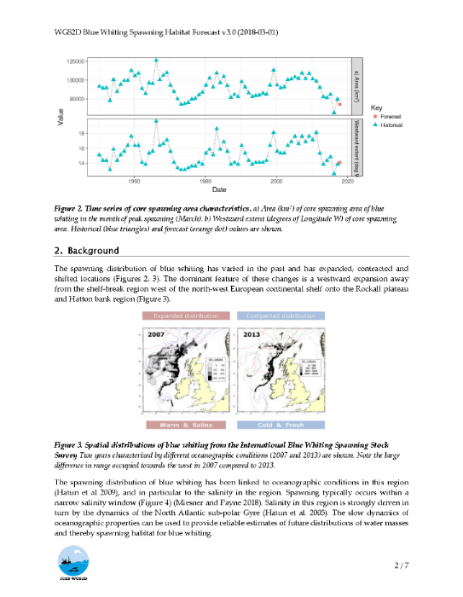
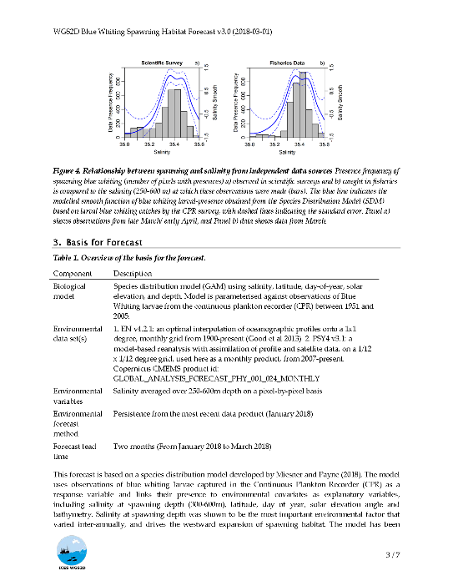
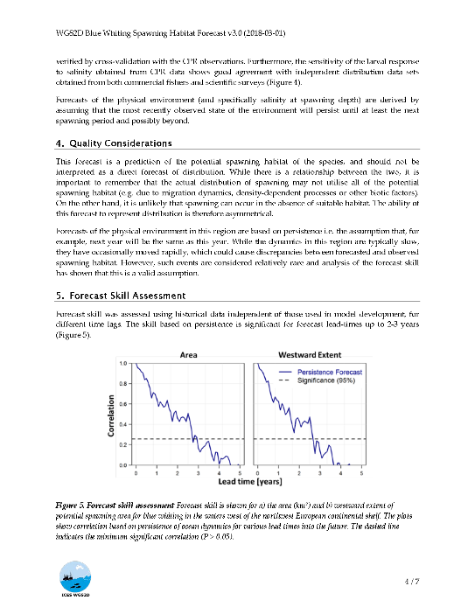
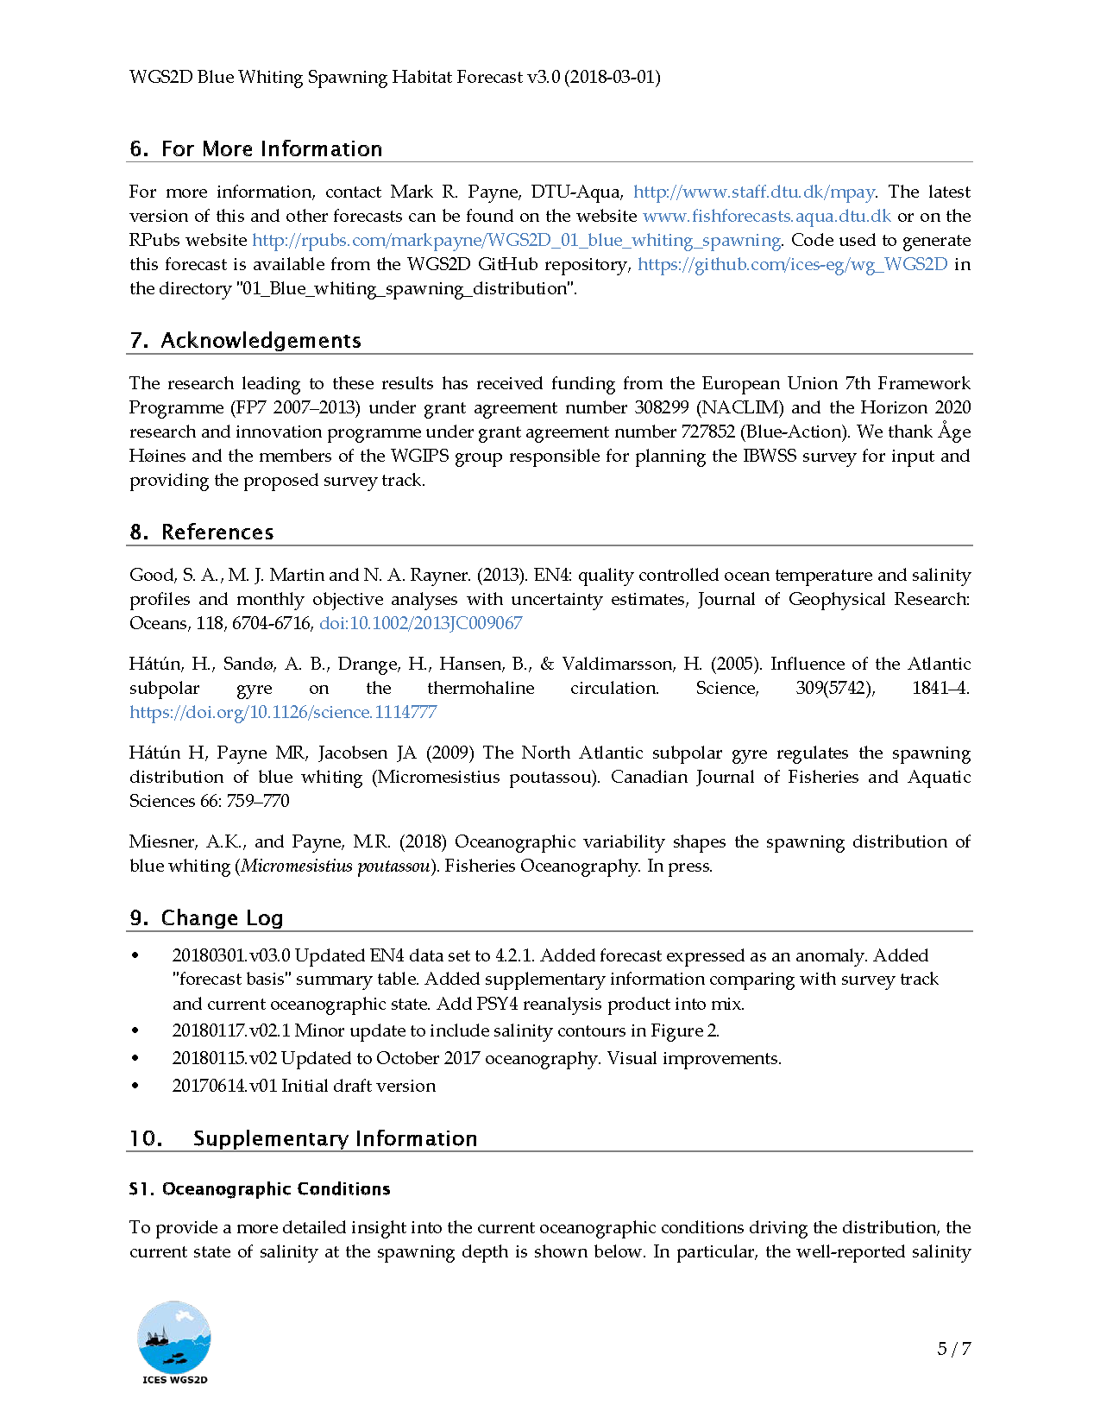
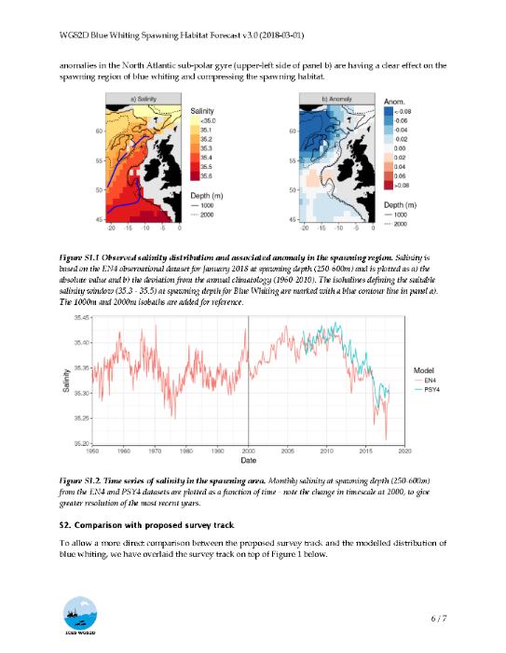
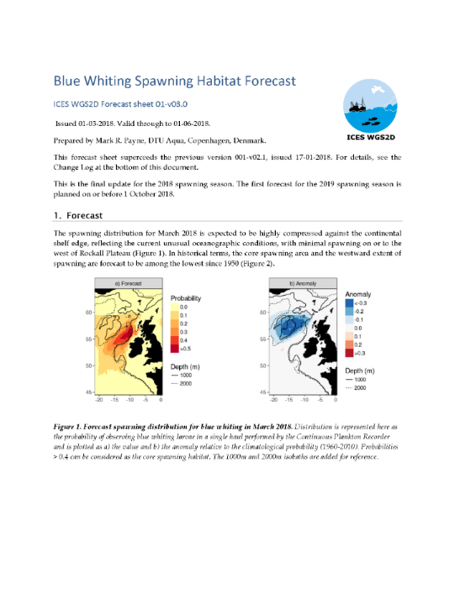
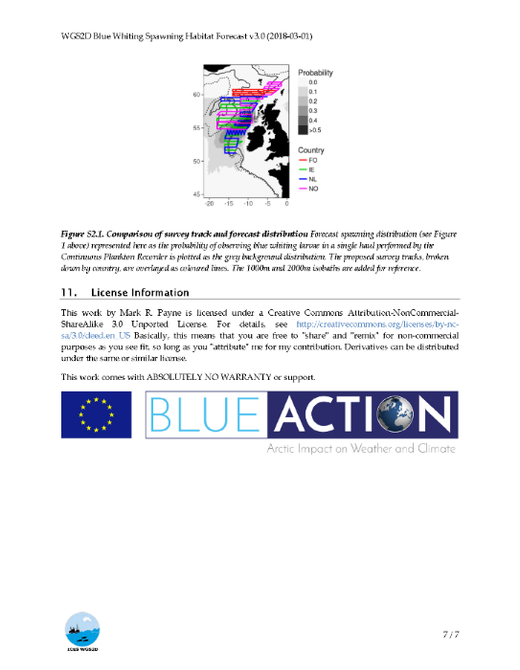
Management and Monitoring of Fish Stocks Forecast blue whiting distribution
http://fishforecasts.dtu.dk

Slide 7
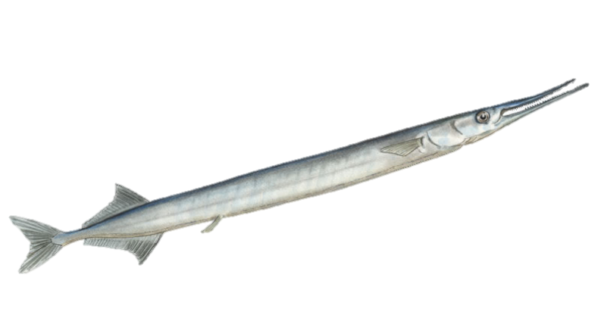
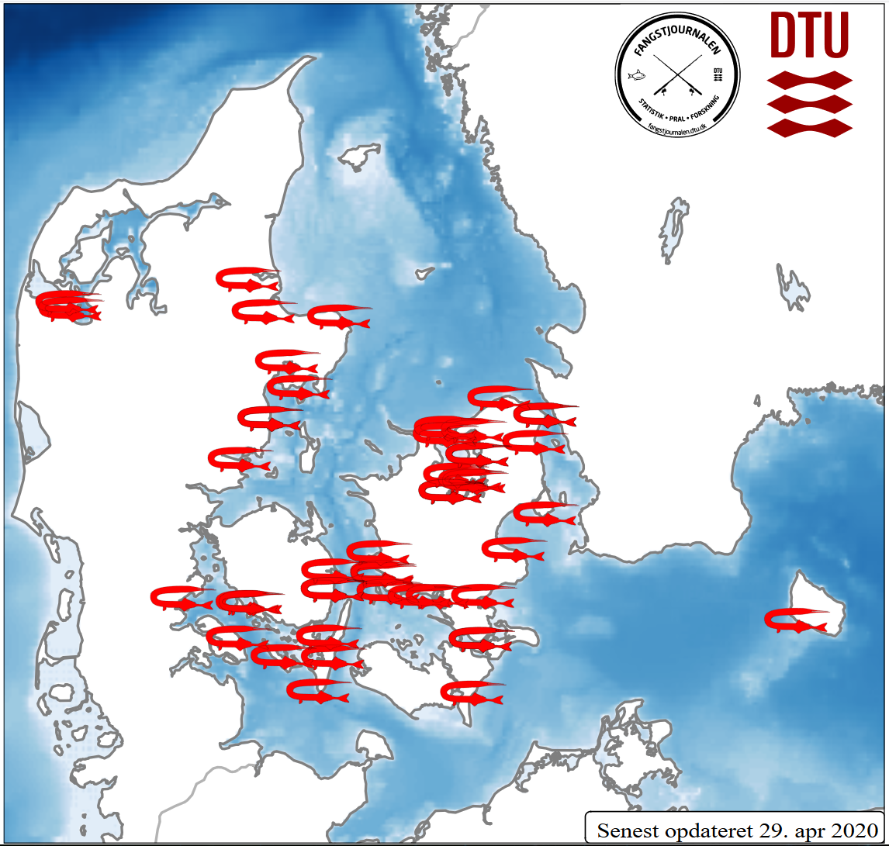
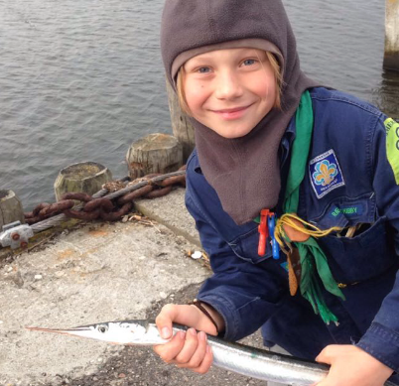
Recreational fishers Garfish monitoring (and forecast) system
Reporting of catches based on pre-existing citizen-science app
Data visualisation provided online and back to users
Forecast system currently under development

Slide 8
Commercial Fisheries Forecasts of Productivity of Sandeel

Slide 9
Research Gaps
Gap 1: Scalabilty of forecasting
to other fish species
currently focused on narrow set of species
expand to wider set of applications
to other geographical areas
currently focused on open ocean
move onto continential shelf, regional seas
other regions globally
to other biological responses
currently focused on productivity and distribution
expand to e.g. growth, maturation
Notes:
Research gaps gaps still present in your research field that need to be still explored/funded (these are key inputs to policy-relevant discussion later

Slide 10
Research Gaps
Gap 2: Using forecasting to improve sustainability
Incorporation into existing European management
setting of quota
Management plans
Globally e.g via UN Decade of Ocean Science for Sustainable Development
”A predicted ocean” is one of six themes
Where can forecasting improve sustainability?
Which regions/countries? Species? Responses?
How do we transfer technology to the Global South?
Notes:
Research gaps gaps still present in your research field that need to be still explored/funded (these are key inputs to policy-relevant discussion later

Slide 11
Research Gaps
Gap 3: Operationalisation of products
Seasonal forecast systems (e.g. C3S) have poor representation of the ocean
only temperature
no subsurface variables
only open ocean – no coastal regions
Regular production of decadal forecasts
prerequisite for production of decadal climate services
Notes:
Research gaps gaps still present in your research field that need to be still explored/funded (these are key inputs to policy-relevant discussion later

Slide 12
Thank you!
The Blue-Action project has received funding from the European Union’s Horizon 2020 research and innovation programme under grant agreement No 727852
Twitter: @BG10Blueaction
Zenodo: https://www.zenodo.org/communities/blue-actionh2020
www.blue-action.eu

